Slide 1


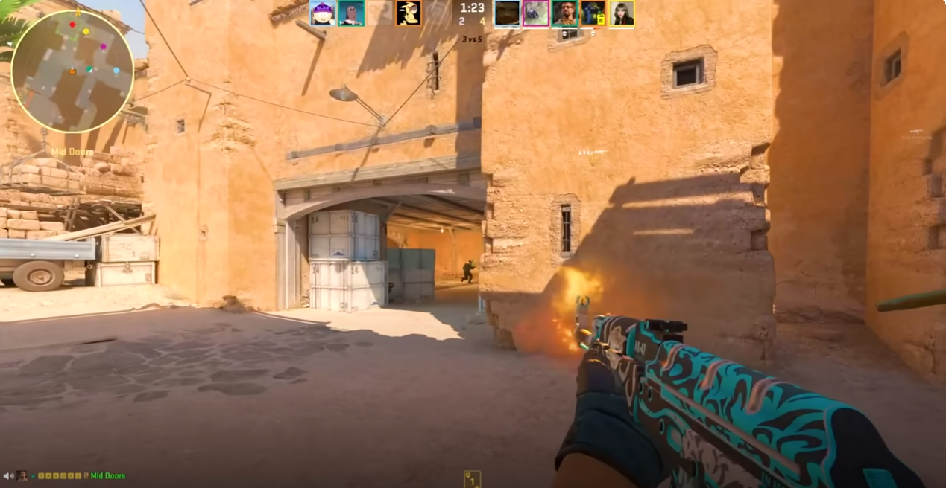
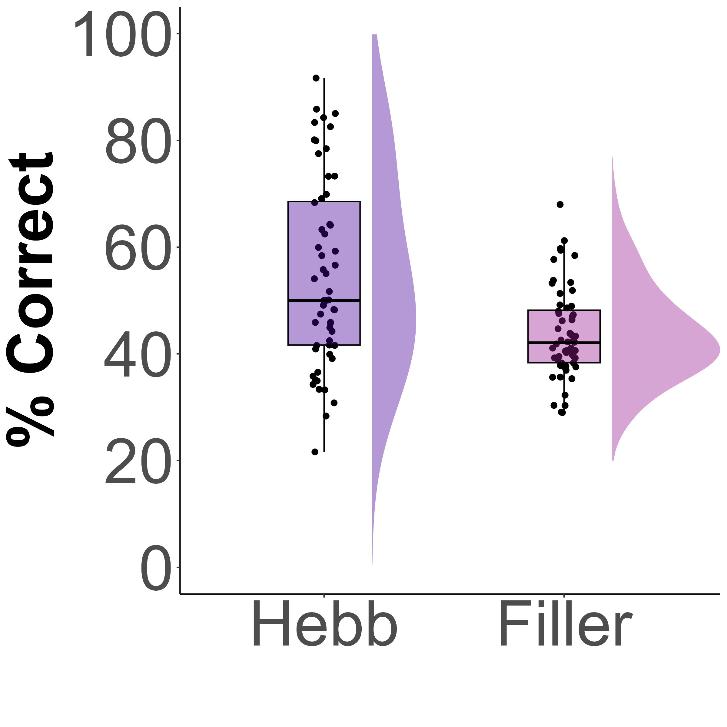
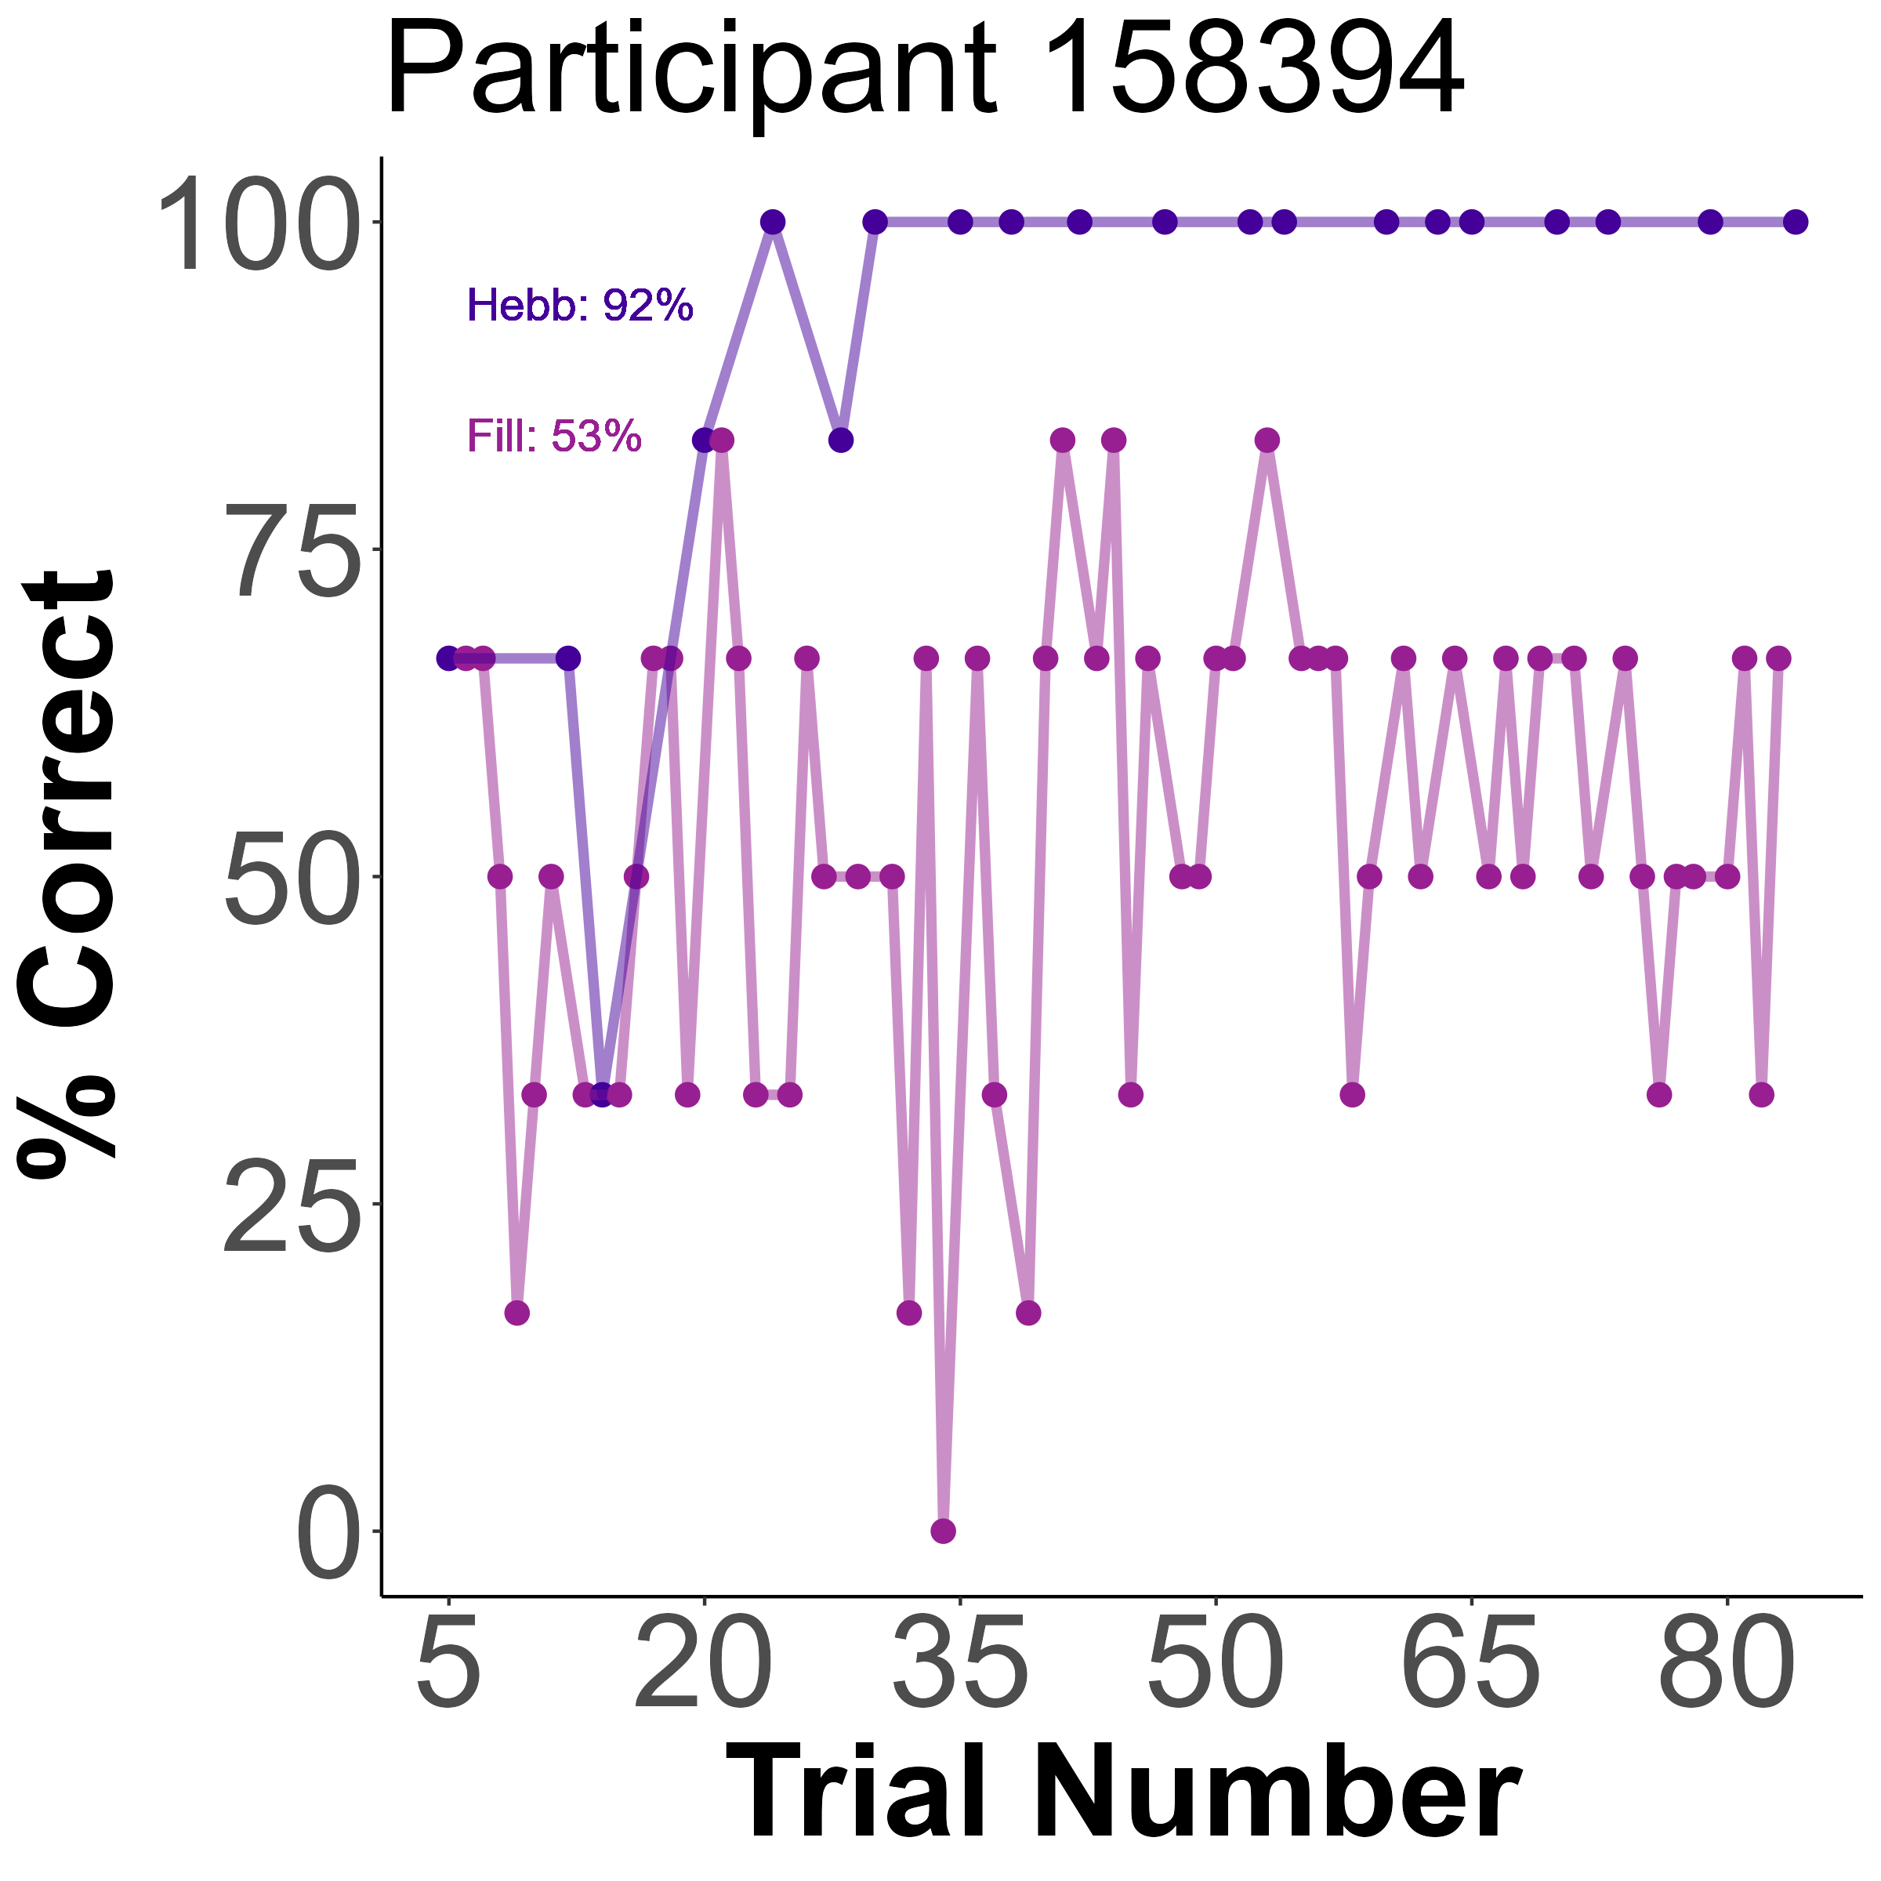
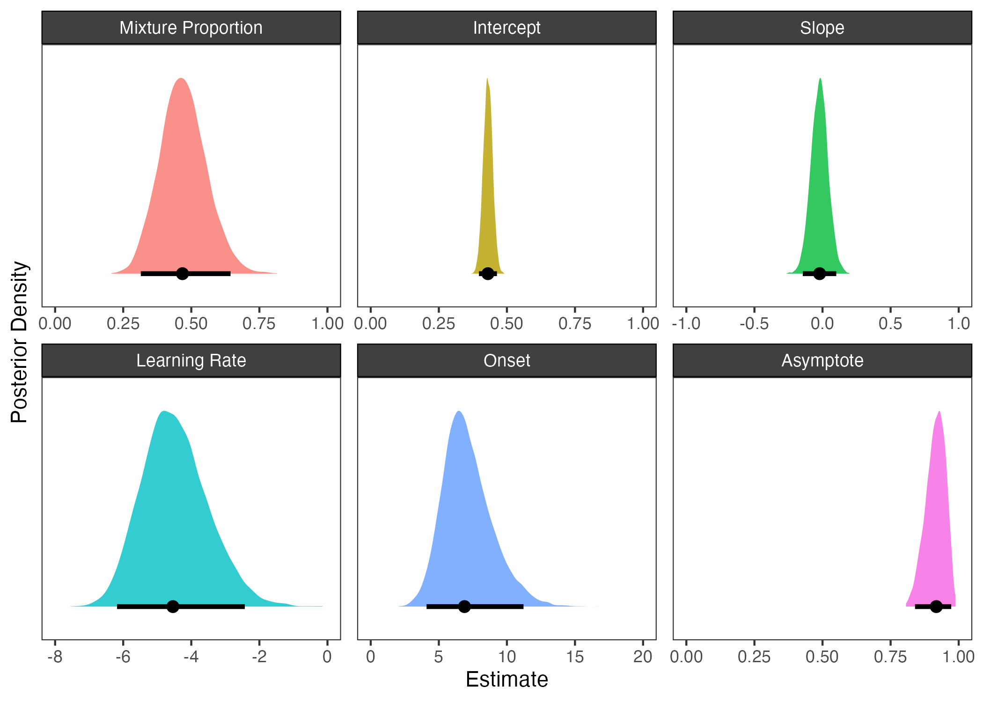
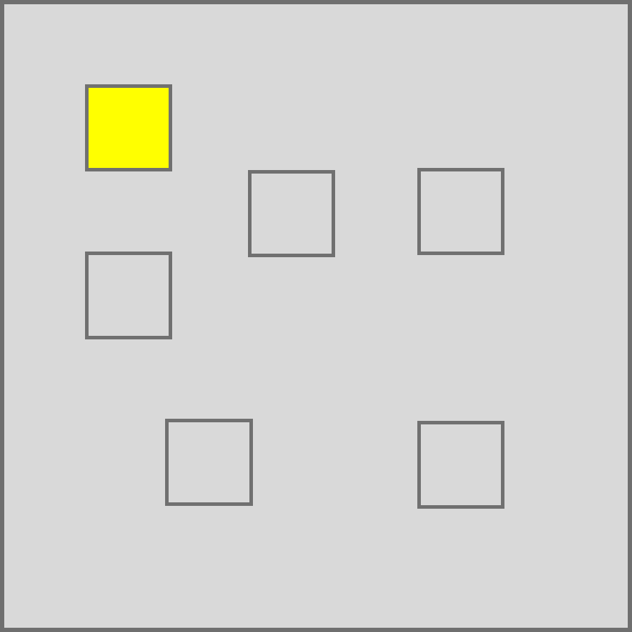
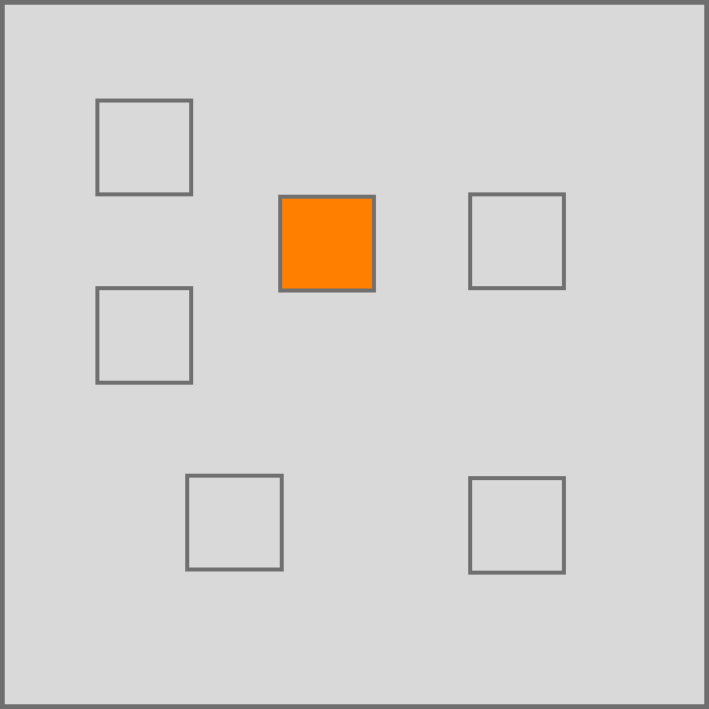
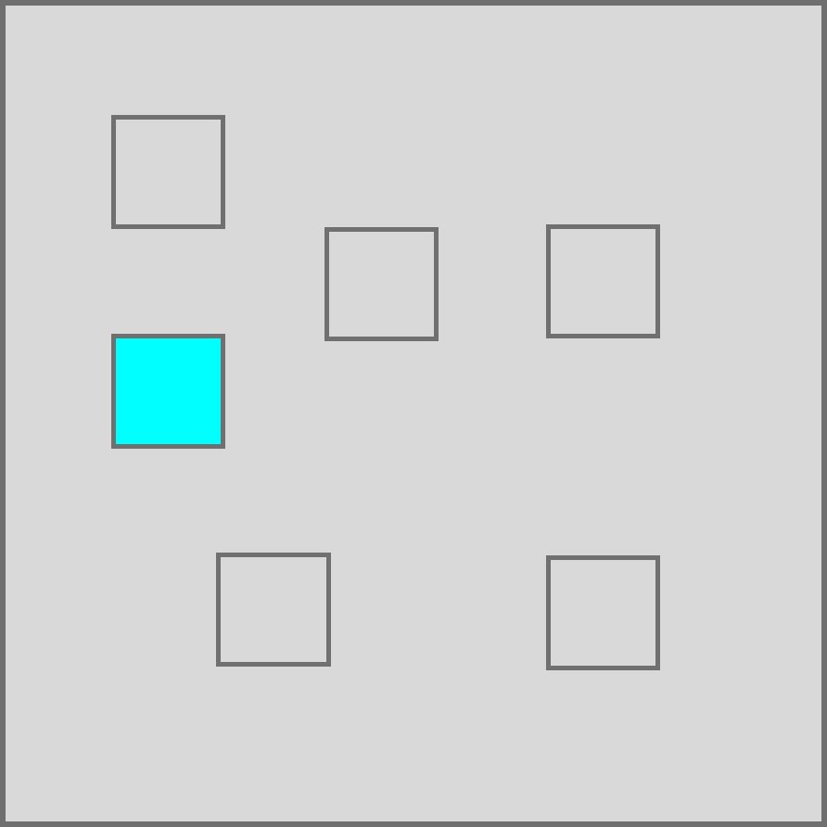
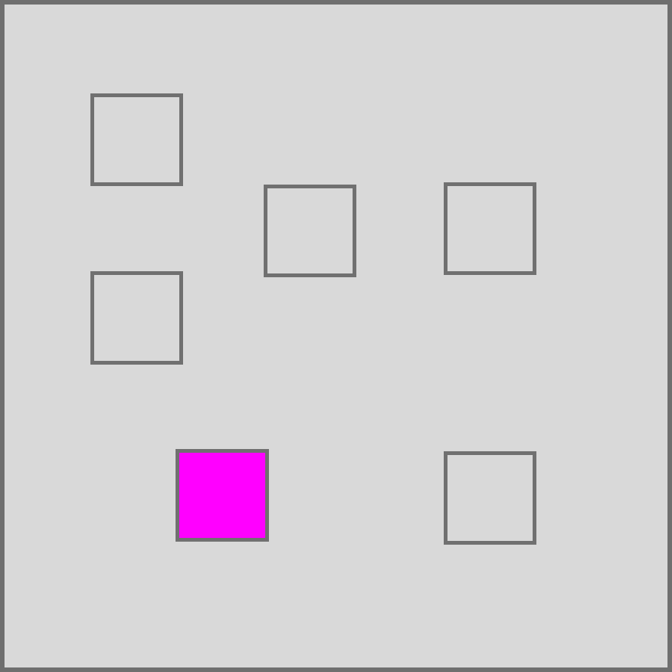
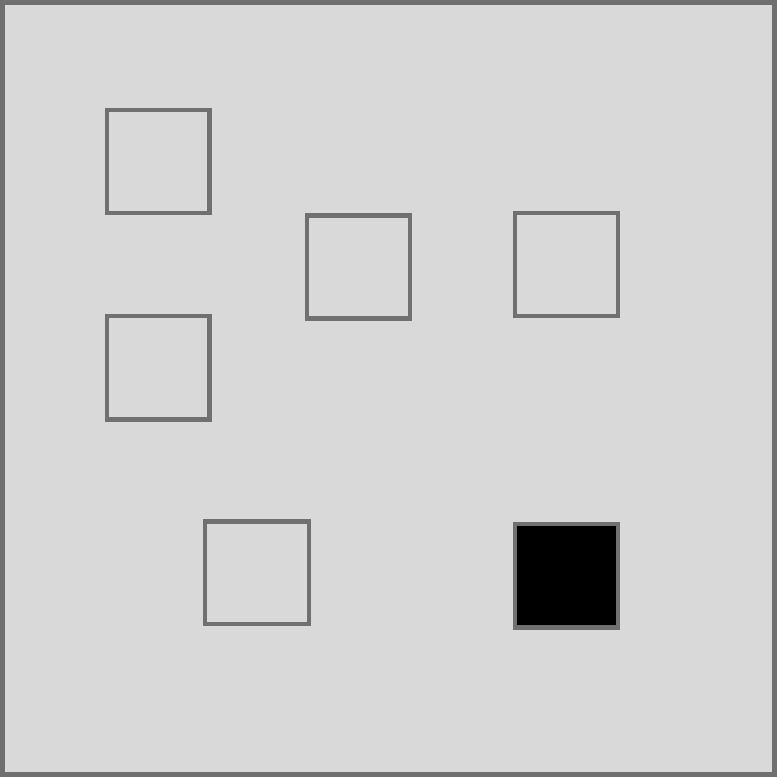
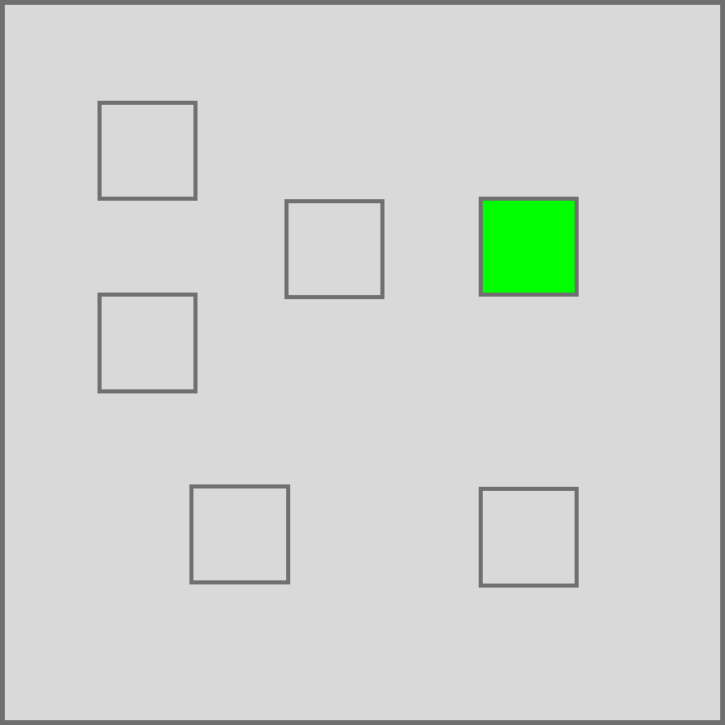
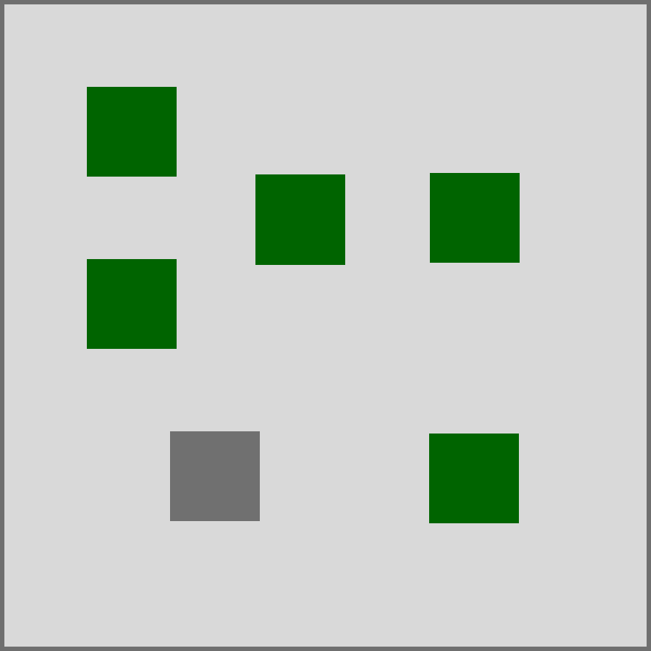
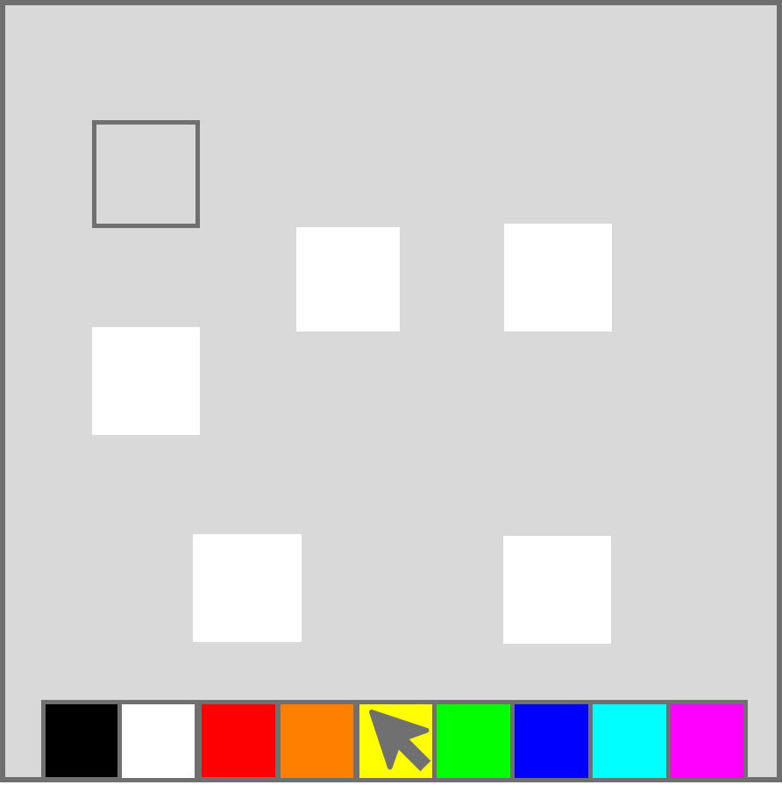
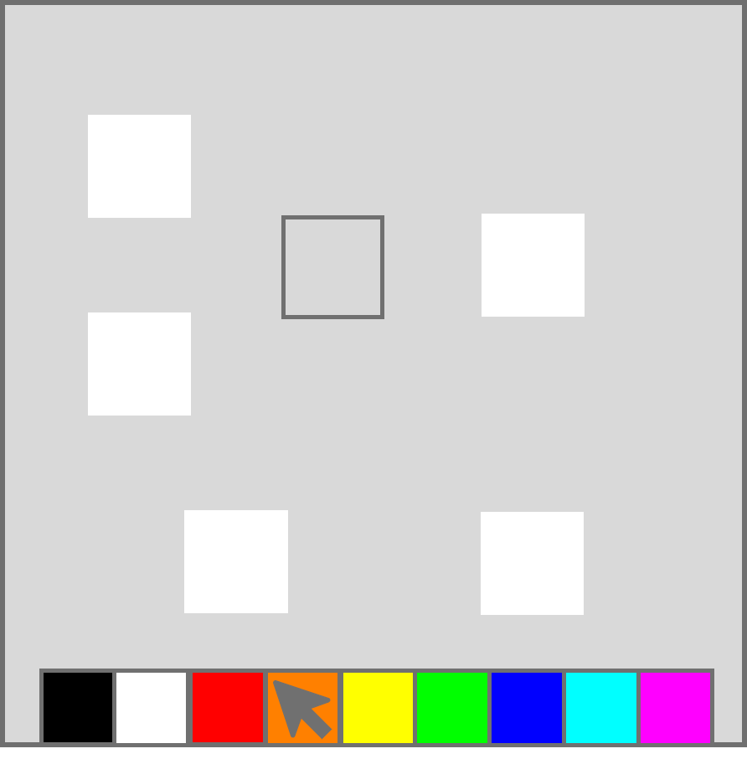
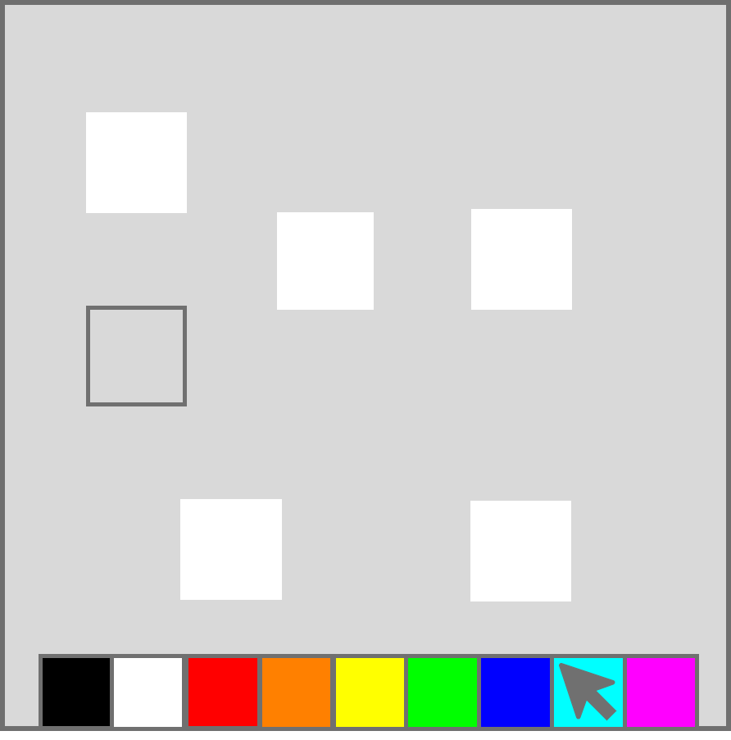
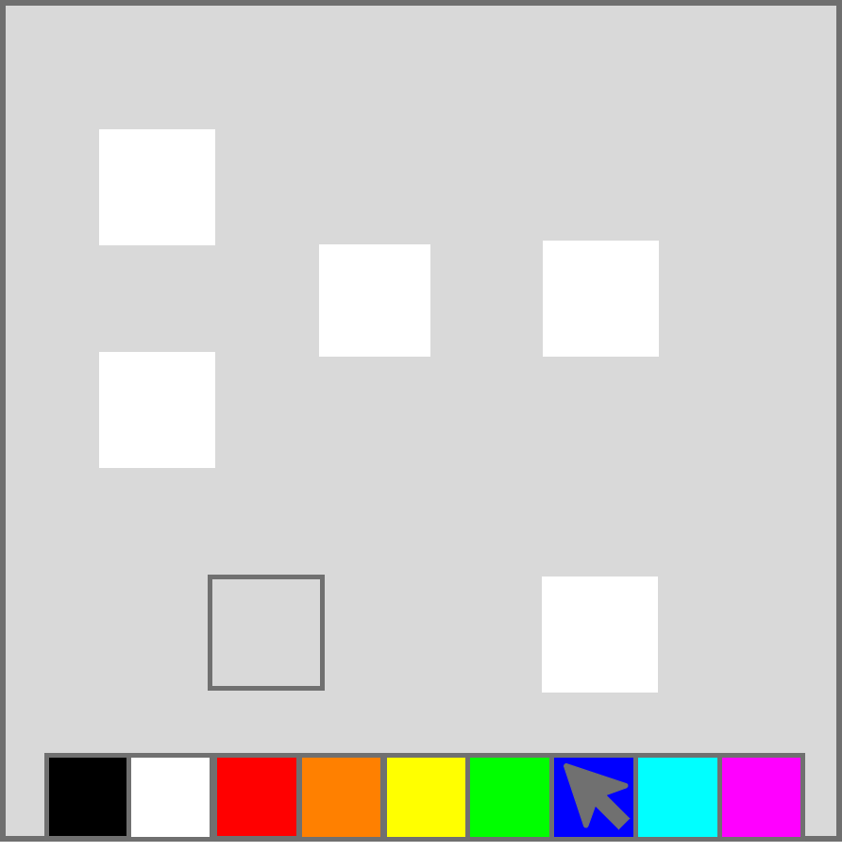
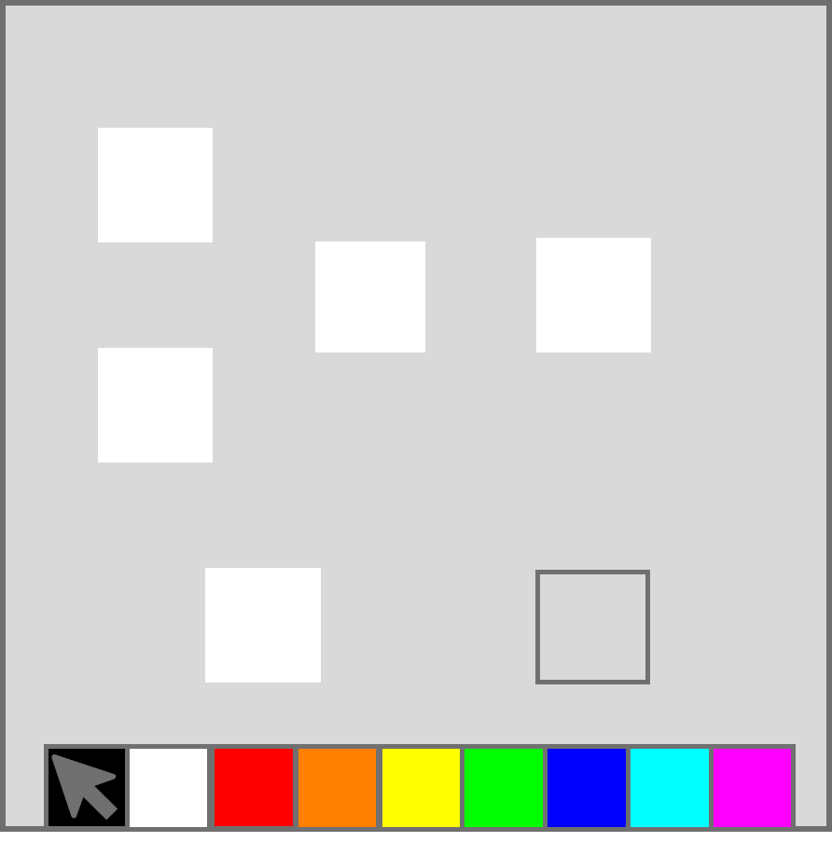
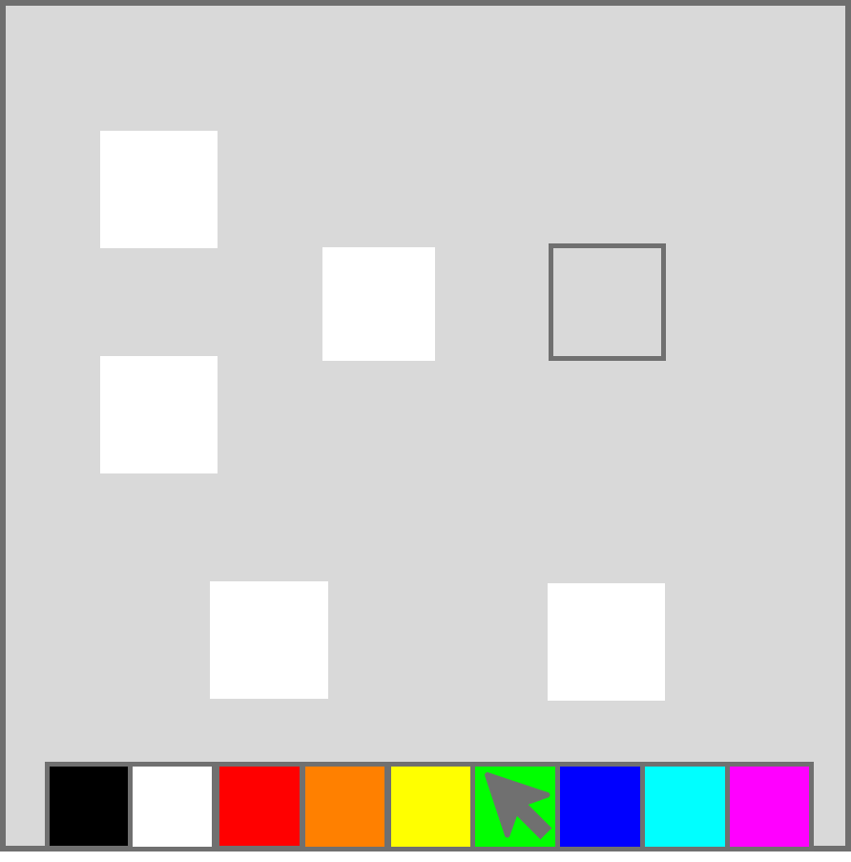
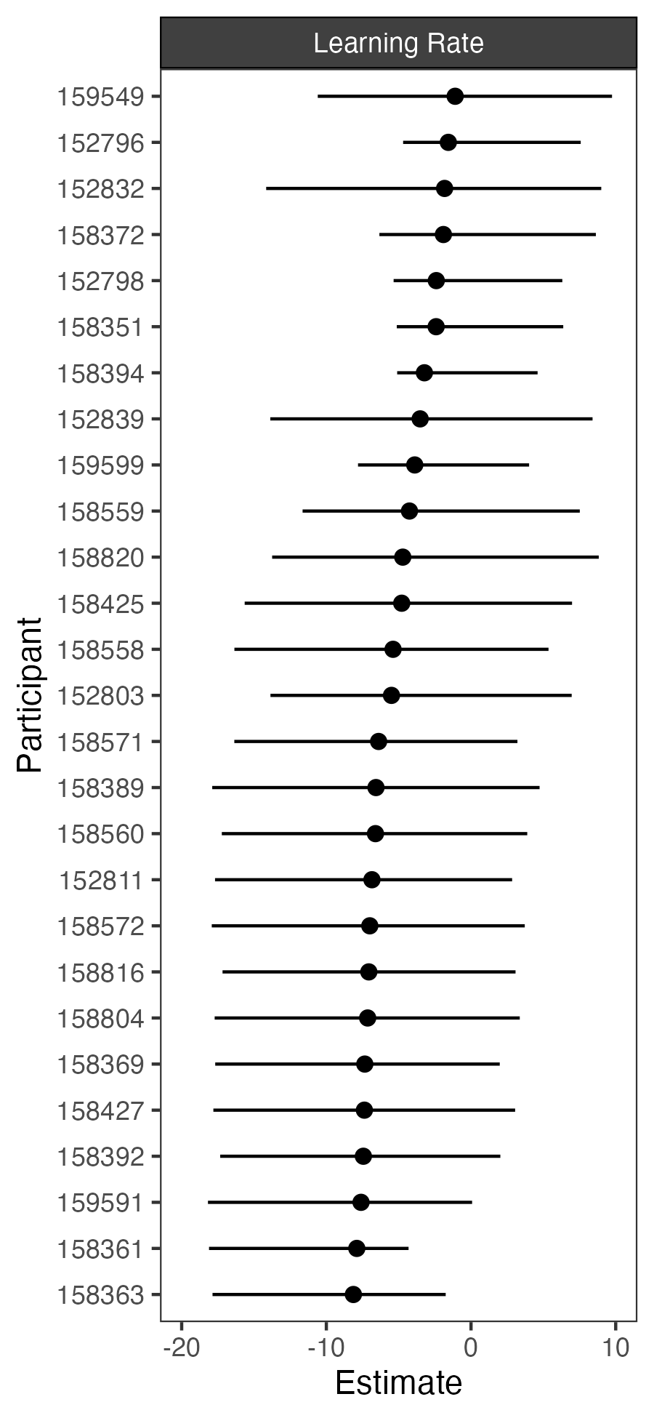
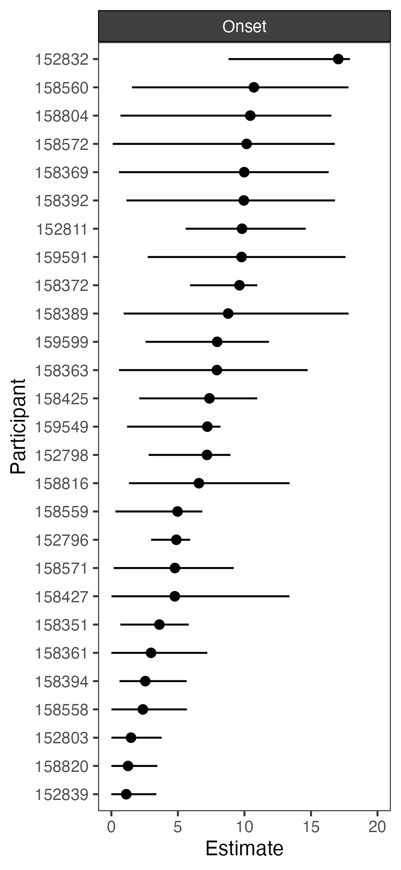



HEBB-REPETITION LEARNING IN PLAYERS OF THE VIDEO GAME COUNTER-STRIKE
Eleanor R. A. Hyde¹, Philipp Musfeld², Robert Schmidt³, Daniel J. Carroll¹, Claudia C. von Bastian¹
¹University of Sheffield, ²University of Zürich, ³Ruhr-Universität Bochum
3126
erahyde1@sheffield.ac.uk
Background
Results
Research shows associations between video gameplay and performance across various cognitive domains (Bediou et al., 2018; 2023).
A potential mechanism is ‘Learning to Learn’, where gaming expertise facilitates faster learning on novel tasks (Zhang et al., 2021, Bavelier, et al., 2012).
Population Accuracy
Individual Accuracy
p < .001, BF = 87.20
Counter-Strike 2
Percentage Correct
Percentage Correct
The Hebb-repetition learning paradigm (Hebb, 1961), which assesses learning through repeated sequence exposure, has not yet been tested in gamers but may reveal enhanced probabilistic inference or pattern recognition, supporting ‘Learning to Learn’.
Hebb:
M = 54.81,
SD = 17.54
Filler:
M = 43.67, SD = 8.46
BAYESIAN HIERARCHICAL MIXTURE MODELLING
Estimates population-level and individual-level parameters, whilst accounting for individual variability in the learning curve (Musfeld et al., 2023).
Learning Parameters:
Mixture Proportion: % of trials where learning occurs
Intercept: initial performance before learning
Slope: rate of performance improvement per repetition
Learning rate: rate of progression from baseline to learning
Onset: point where learning begins
Asymptote: point where performance levels off
Identified Learners (n = 27) and Non-Learners (n = 29)
COUNTER-STRIKE EXPERTISE
No clear evidence supporting a relationship between Counter-Strike expertise and Learner group status.
Trial Number
Population Learning Parameters
Method
VISUOSPATIAL HEBB-REPETITION TASK (Musfeld et al., 2023)
Unbeknownst to participants, one HEBB sequence is ( on average) repeated every fourth trial, while other FILLER sequences are not repeated.
COUNTER-STRIKE EXPERTISE QUESTIONNAIRE
Total hours of playtime
Fortnightly hours of playtime
Self-rated expertise
Current in-game ranking
PARTICIPANTS
56 Counter-Strike 2 players aged 16-35 years (M = 24.34, SD = 5.04)
Mostly male (50), from the UK (45), and predominantly white (46)
Mostly well educated (M = 16.07, SD = 2.81), and high self-rated socioeconomic status (SES) (M = 5.88, SD = 1.50)
200ms
200ms
200ms
200ms
200ms
200ms
Posterior Density
Presentation Phase
Feedback Phase
1500ms
Hebb (n = 20)
Filler (n = 60)
Estimate
Recall Phase
Individual Learning Parameters
Participant
References and extra figures!
Limitation: few Hebb trials may have limited exposure to repetitions and learning
Estimate

